Slide 1
Black Fugitivity
February 14, 2017
Notes:
http://www.ajc.com/news/here-every-executive-order-trump-has-signed/pHETsFIm2nYmj4VWlNHmbK/

Slide 2
What is blackness?
Saidiya Hartman writes:
“The demands of the slave on the present have everything to do with making good the promise of abolition, and this entails much more than the end of property in slaves. It requires the reconstruction of society, which is the only way to honor our debt to the dead. This is the intimacy of our age with theirs- an unfinished struggle. To what end does one conjure the ghost of slavery, if not to incite the hopes of transforming the present? Given this, I refuse to believe that the slave’s most capacious political claims or wildest imaginings are for back wages or debt relief. There are too many lives at peril to recycle the forms of appeal that, at best, have delivered the limited emancipation against which we now struggle.”
Hartman, Lose Your Mother

Slide 3
What is fugitivity?
Fred Moten writes:
“What's at stake is fugitive movement in and out of the frame, bar, or whatever externally imposed social logic—a movement of escape, the stealth of the stolen that can be said, since it inheres in every closed circle, to break every enclosure. This fugitive movement is stolen life, and its relation to law is reducible neither to simple interdiction nor bare transgression. Part of what can be attained in this zone of unattainability, to which the eminently attainable ones have been relegated, which they occupy but cannot (and refuse to) own, is some sense of the fugitive law of movement that makes black social life ungovernable, that demands a para-ontological disruption of the supposed connection between explanation and resistance.
Moten, Fred. “The Case of Blackness.” Criticism 50, no. 2 (February 22, 2009): 177–218.

Slide 4
What is black studies?
Katherine McKittrick writes:
“Indeed, while not always honored, the intellectual project of black studies—with its long history of citing and surviving racial violence in numbers—provides a deliberate commentary on the ways in which blackness works against the violence that defines it.”

Slide 5
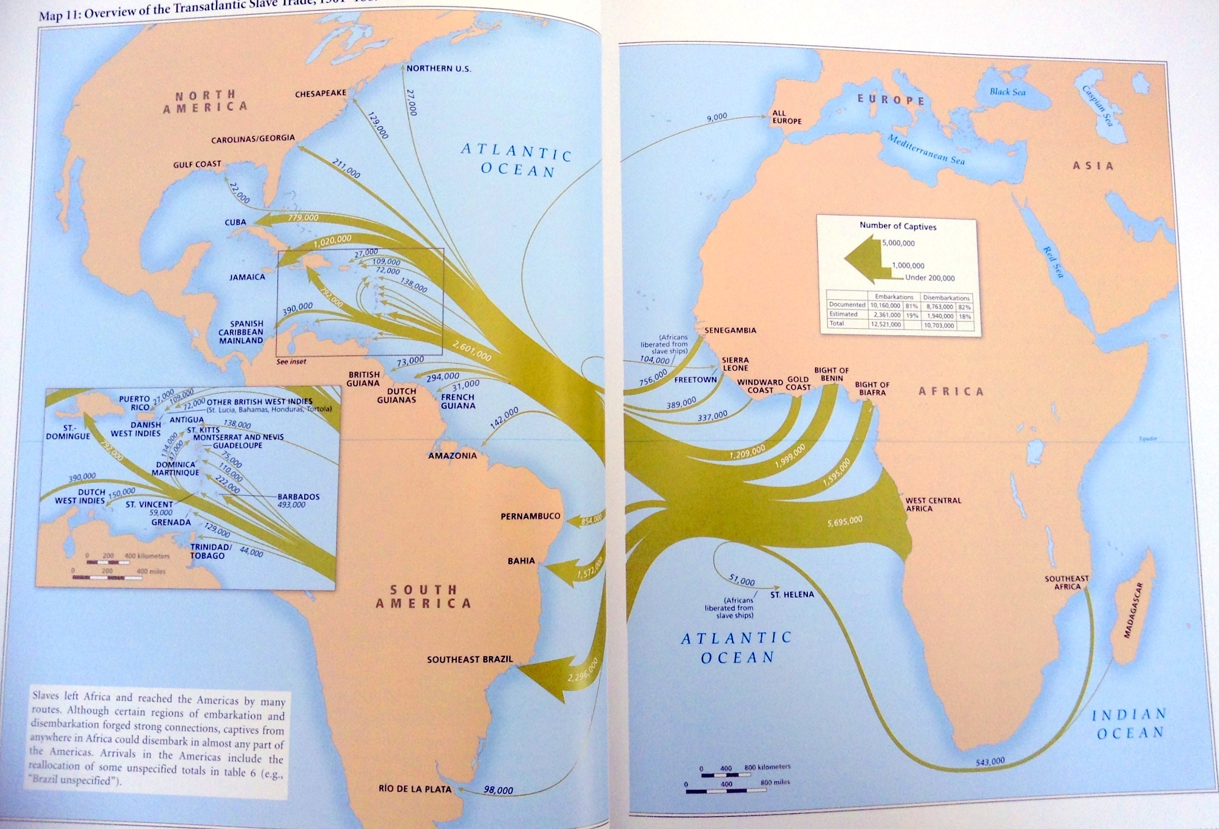

Slide 6


Slide 7
McKittrick:
“The archive of black diaspora is, as Hartman rightly suggests, “a death sentence, a tomb, a display of a violated body, an inventory of property, a medical treatise…an asterisk in the grand narrative of history.””

Slide 8
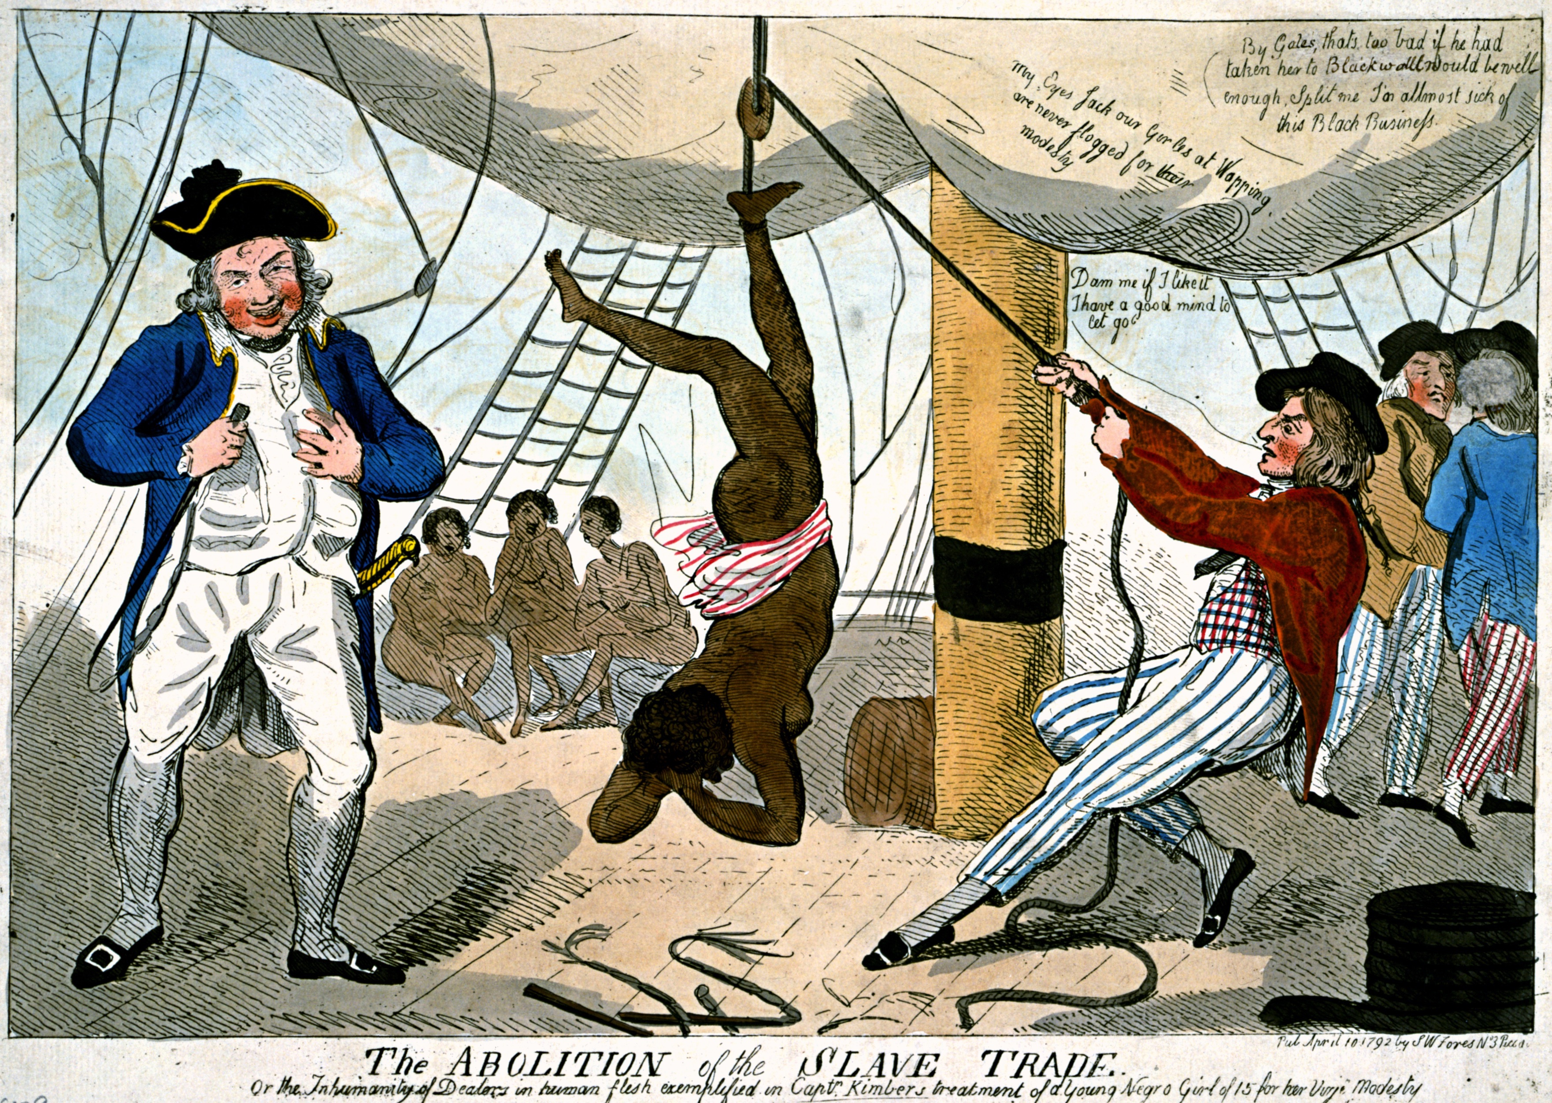
Notes:
^{Captain John Kimber}
flogged to death a 15 year old girl
Kimber was arrested and tried in 1792 but was acquitted.

Slide 9
McKittrick:
“New world blackness arrives through the ordinary, proved, former, certified, nearly worn-out archives of ledgers, accounts, price tags, and descriptors of economic worth and financial probability.”
“Yet a voice interrupts: says she.”

Slide 10
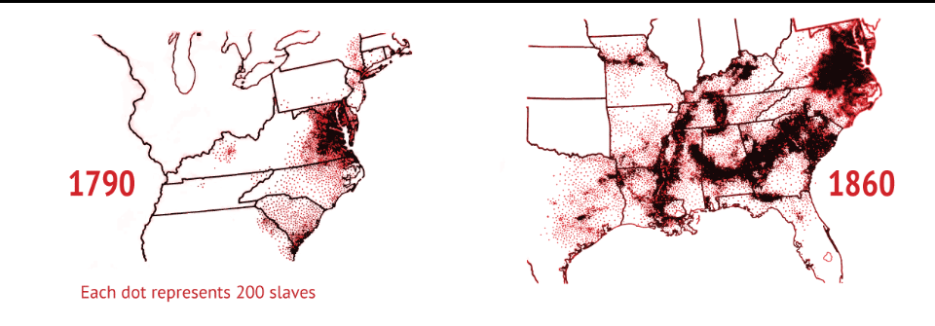

Slide 11
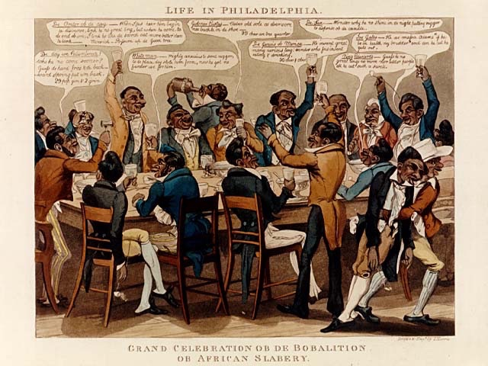

Slide 12
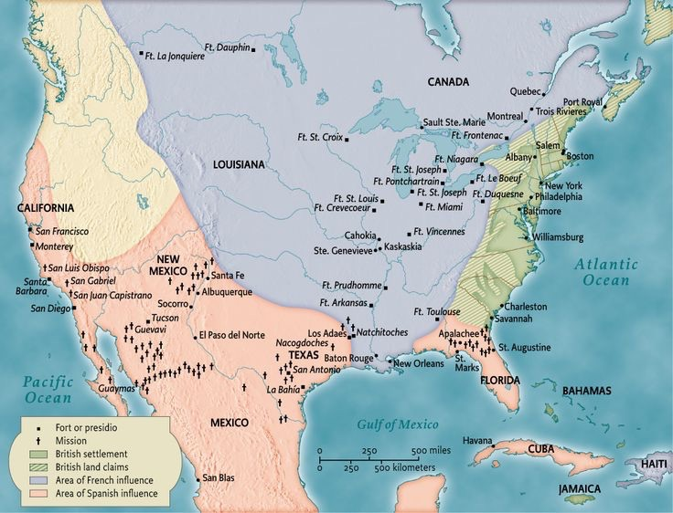

Slide 13
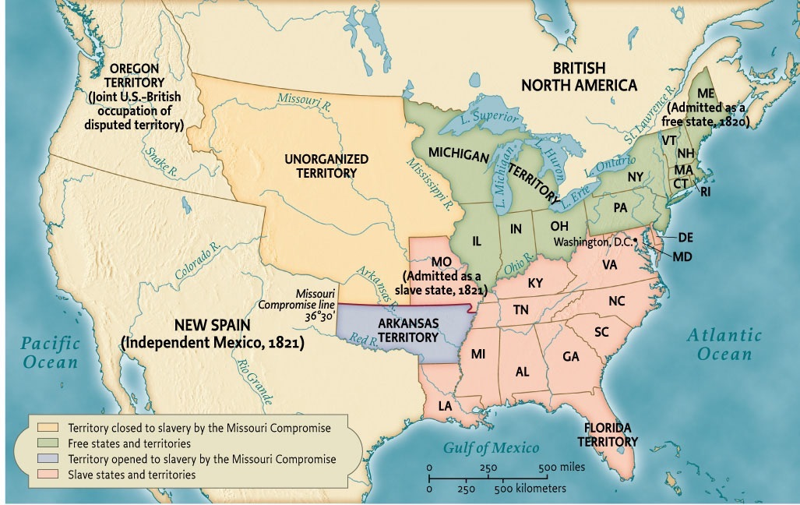

Slide 14
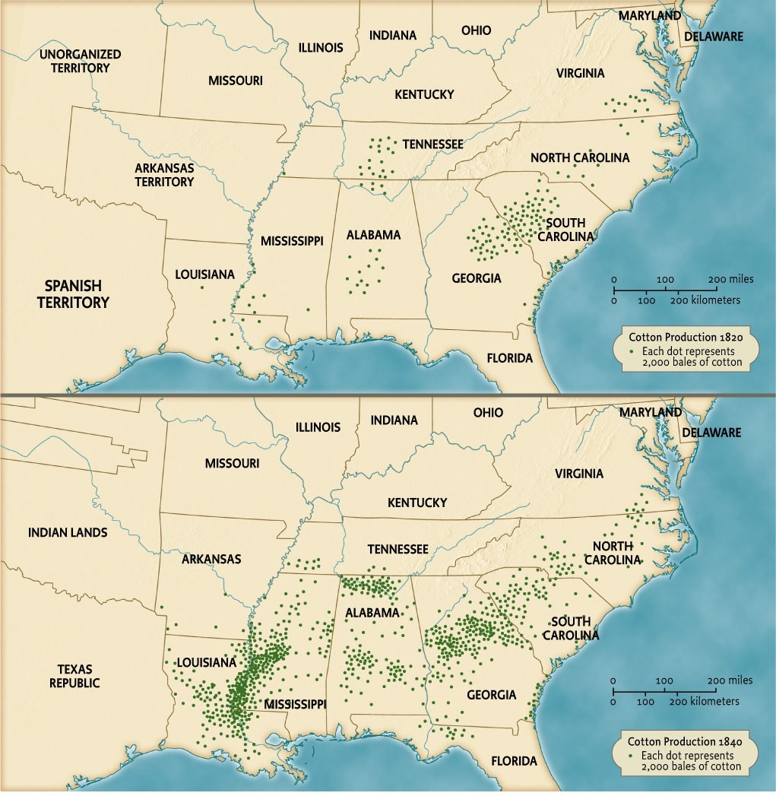

Slide 15
